Slide 1
Video Seam Carver
基于内容的视频、图片裁剪
汇报人：林阳昊 刘佰川 廖烙锋
汇报时间：2019.06.14

Slide 2
CONTENTS
1
2
3
4
基本算法讲解
算法应用
结果展示
总结与展望

Slide 3
Part one
基本算法讲解

Slide 4
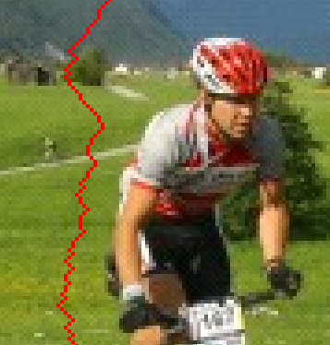
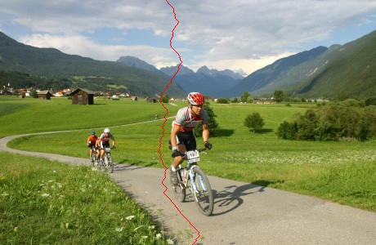
A Seam
Notes:
A vertical seam is a vertical path from the top of the image to the bottom containing just one pixel in each row.
Similarly we can define a horizontal seam from left to right.

Slide 5
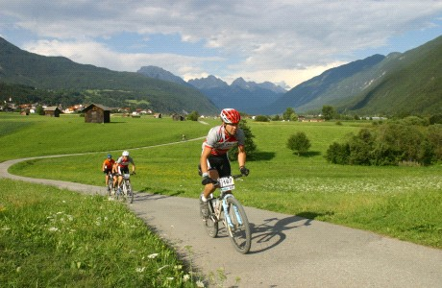
Finding the Seam?
Notes:
The question is how to find the right seam to remove

Slide 6
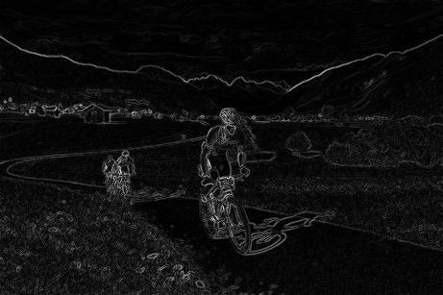
The Optimal Seam
$$E\left(I\right)=\left|\frac{∂}{∂x}I\right|+\left|\frac{∂}{∂y}I\right|→s^{∗}=\underset{s}{argmin}E(s)$$
Notes:
This can be done using some energy function and choosing the seam with least amount of energy

Slide 7
Pixel Attribute → Dynamic Programming
$$M\left(i,j\right)=E\left(i,j\right)+\min\left(M\left(i−1,j−1\right),M\left(i−1,j\right),M\left(i−1,j+1\right)\right)$$
5 | 8 | 12 | 3
9 | 2 | 3 | 9
7 | 3 | 4 | 2
4 | 5 | 7 | 8
Notes:
We have shown how this could be done in an efficient manner on images using dynamic programming

Slide 8
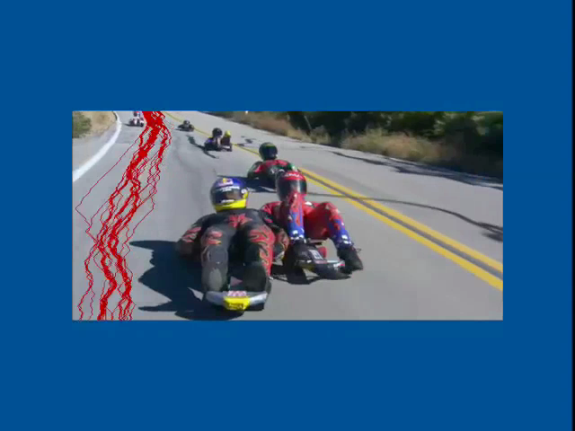
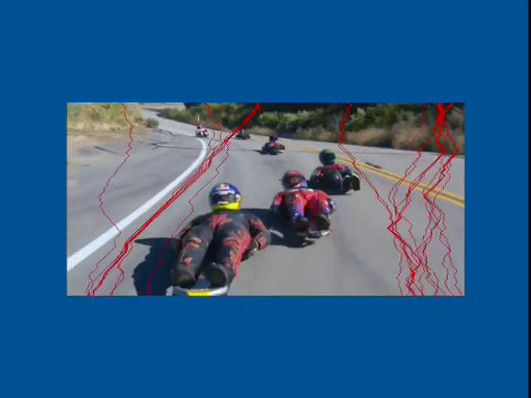
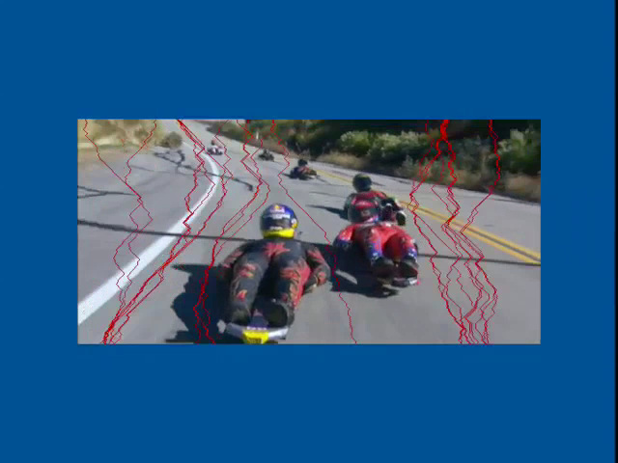
Video?
Naive… frame by frame independently
Time

Slide 9
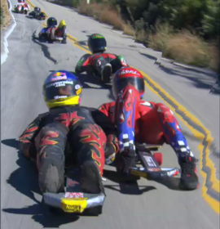
Jittery Results

Slide 10
Global Solution
Video Cube

Slide 11
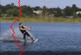
One 3D Seam

Slide 12
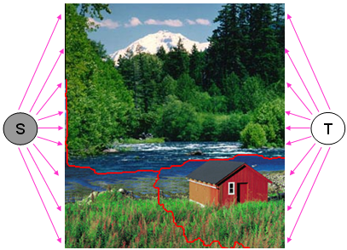
What is the challenge?
How to Define a Seam from a Cut?
Notes:
We would like to find cuts that separate the image into two part and therefore instead of connecting all pixels as usually done in graph cut on images, we connect the right and left columns only to S and T.

Slide 13


Standard Construction
p_{i,j}
p_{i,j+1}
∂x
∂x
p_{i,j}
p_{i,j+1}
S
T
∂y
∂y
∂y
∂y
p_{i+1,j}
p_{i+1,j+1}
p_{i+1,j}
p_{i+1,j+1}
∂x
∂x
Notes:
Now lets examine the graph constructed. We concentrate on four adjacent pixels, but this graph structure repeats over the whole image

Slide 14
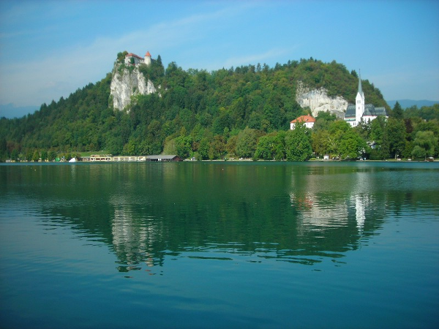
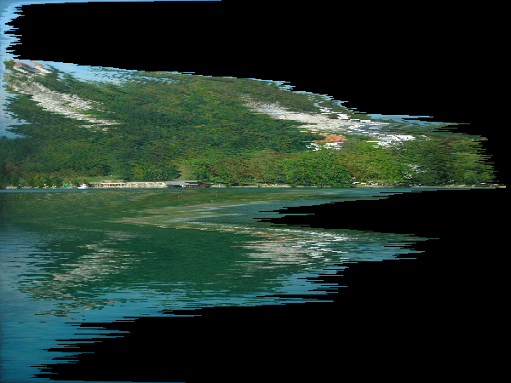
Constraints
Seams should be monotonic!
i.e. one pixel in each row
Non-monotonic

Slide 15
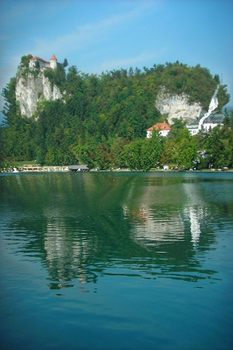
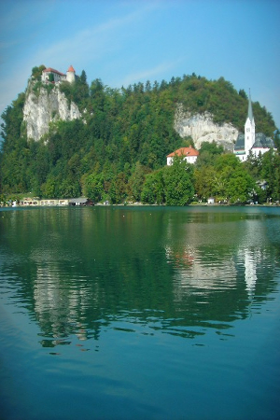
Constraints
Seams should be monotonic!
Seams should be connected!
Unconnected
Piecewise
Connected

Slide 16
Piecewise vs. Connected

Slide 17
New Construction
This construction guarantees monotonic and connected seams
This construction creates seams that are equivalent to the dynamic programming approach
p_{ij}
E1
p_{i,j+1}
∞
∞
∞
p_{i+1,j}
E1
p_{i+1,j+1}
∞

Slide 18
New Construction Guarantees Monotonic Seams
p_{ij}
E1
p_{i,j+1}
∞
∞
∞
p_{i+1,j}
E1
p_{i+1,j+1}
∞

Slide 19
New Construction Guarantees Connected Seams
p_{ij}
E1
p_{i,j+1}
∞
∞
∞
p_{i+1,j}
E1
p_{i+1,j+1}
∞

Slide 20
3D Graph Construction
Frame t+2
Time
Frame t+1
Frame t
Video Cube

Slide 21
Part two
算法应用

Slide 22
任意裁剪
思路：横向伸缩 -> 图片翻转 ->横向伸缩

Slide 23
物品消除
思路：目标内的像素需要移除
-> 连接的边权重小
-> 通过该边的割(cut)流更小
-> 该边被移除
技巧：Mask
移除seam后，动态记录余下待移除像素的位置

Slide 24
Part three
结果展示

Slide 25
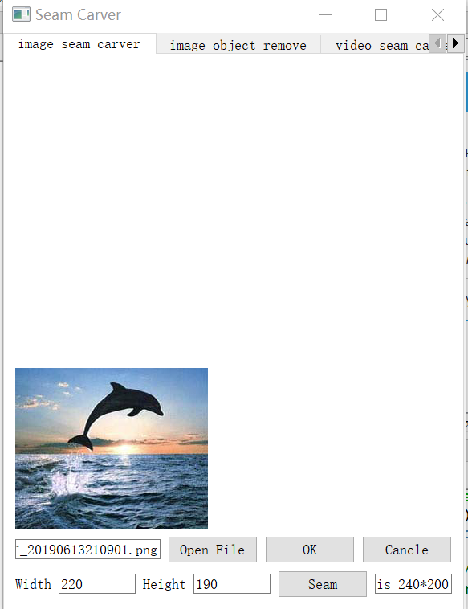
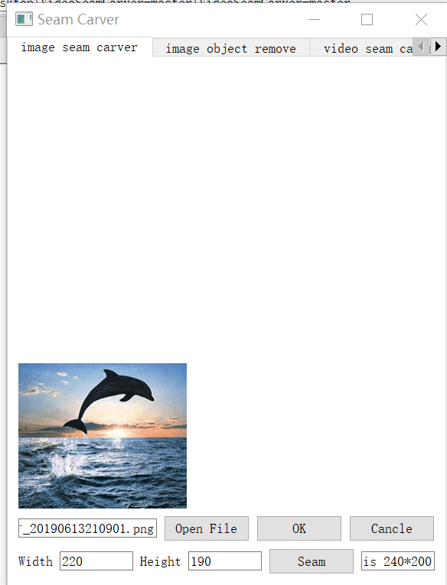
图像裁剪
带有seams的动态结果展示（扩增和缩小）
为了显示结果，图片保持原尺寸

Slide 26
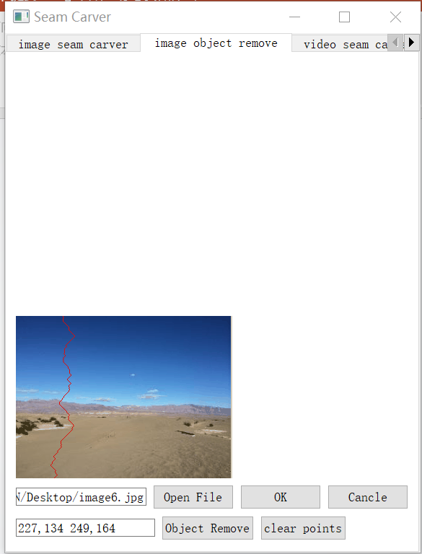
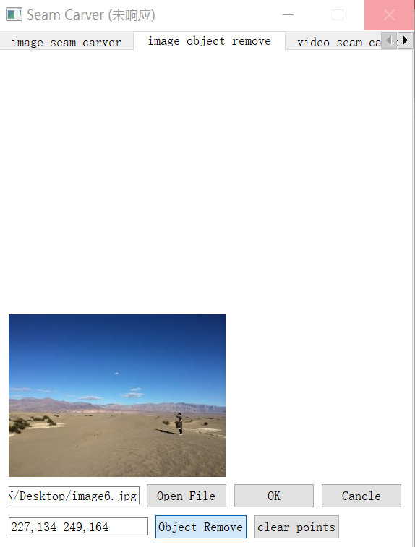
图像消除
带有seams的动态结果展示（物品消除）

Slide 27
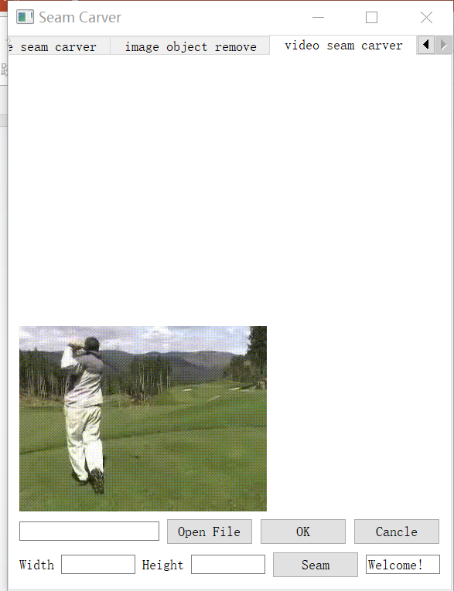
视频裁剪
带有seams的动态结果展示（缩小）
PyQt目前只显示gif

Slide 28
Part four
总结与展望

Slide 29
完成的任务
构建算法所需数据结构，独立实现了算法并应用算法到图像视频
在图像上完成物品移除任务
完成前端构建

Slide 30
改进的空间
算法时间复杂度较高
目前使用的能量函数较为单一

Slide 31
参考资料
Avidan S , Shamir A . Seam carving for content-aware image resizing[J]. ACM Transactions on Graphics, 2007, 26(3):10.
Rubinstein M , Shamir A , Avidan S . Improved seam carving for video retargeting[J]. ACM Transactions on Graphics, 2008, 27(3):1.
PPT部分资料来源于http://www.faculty.idc.ac.il/arik/SCWeb/vidret/results/video_results.html

Slide 32
Q&A

